Slide 1
rating SJT from Q61 to 114
Wednesday, December 09, 2020

Slide 2
244
Total Responses
Date Created: Saturday, November 28, 2020
Complete Responses: 234

Slide 3
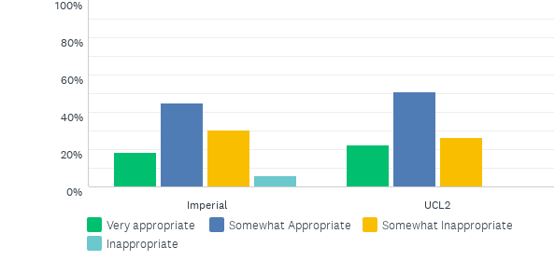
Q1: 61. "The consultant asked for the chest x-ray but I’m not sure why.”
Answered: 239 Skipped: 3

Slide 4
Q1: 61. "The consultant asked for the chest x-ray but I’m not sure why.”
Answered: 239 Skipped: 3

Slide 5
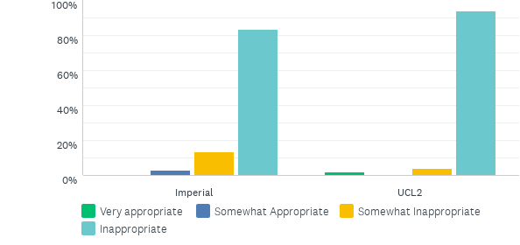
Q2: 62. “I’m not sure why you need one if you had one yesterday; I’ll cancel the chest x-ray.”
Answered: 238 Skipped: 4

Slide 6
Q2: 62. “I’m not sure why you need one if you had one yesterday; I’ll cancel the chest x-ray.”
Answered: 238 Skipped: 4

Slide 7
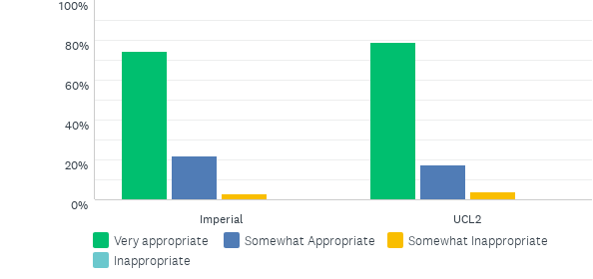
Q3: 63. “I’ll check that the consultant realises that you had a chest x-ray yesterday.”
Answered: 238 Skipped: 4

Slide 8
Q3: 63. “I’ll check that the consultant realises that you had a chest x-ray yesterday.”
Answered: 238 Skipped: 4

Slide 9
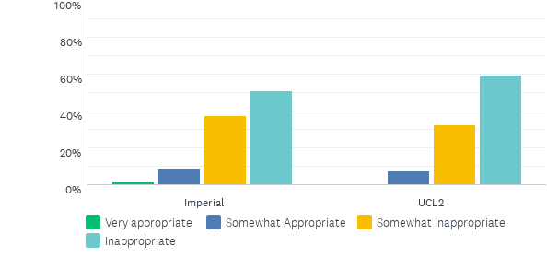
Q4: 64. “There may have been an abnormality on the x-ray yesterday, but I’m not sure.”
Answered: 238 Skipped: 4

Slide 10
Q4: 64. “There may have been an abnormality on the x-ray yesterday, but I’m not sure.”
Answered: 238 Skipped: 4

Slide 11
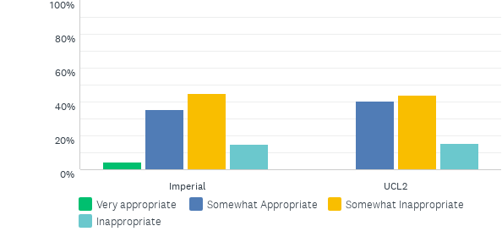
Q5: 65. “It could have been that the picture was not clear enough on yesterday’s x-ray.”
Answered: 238 Skipped: 4

Slide 12
Q5: 65. “It could have been that the picture was not clear enough on yesterday’s x-ray.”
Answered: 238 Skipped: 4

Slide 13
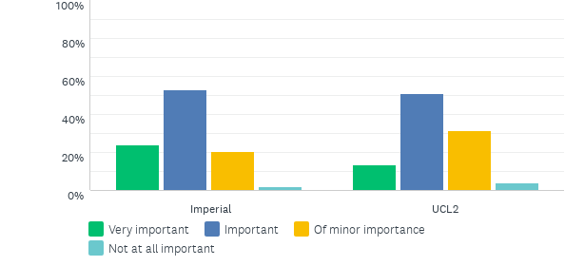
Q6: 66. That Helen and her partner are having a private conversation
Answered: 237 Skipped: 5

Slide 14
Q6: 66. That Helen and her partner are having a private conversation
Answered: 237 Skipped: 5

Slide 15
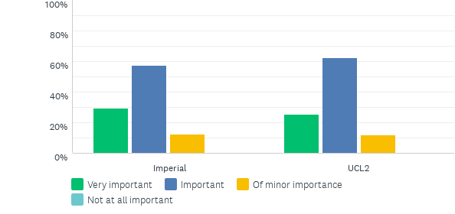
Q7: 67. That the partner’s shouting may be disturbing other patients
Answered: 237 Skipped: 5

Slide 16
Q7: 67. That the partner’s shouting may be disturbing other patients
Answered: 237 Skipped: 5

Slide 17
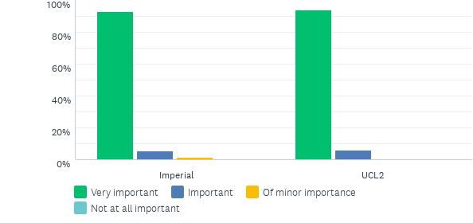
Q8: 68. That Helen’s patient confidentiality is at risk of being compromised.
Answered: 236 Skipped: 6

Slide 18
Q8: 68. That Helen’s patient confidentiality is at risk of being compromised.
Answered: 236 Skipped: 6

Slide 19
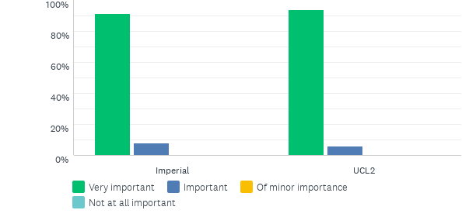
Q9: 69. That Helen’s partner may become physically aggressive.
Answered: 237 Skipped: 5

Slide 20
Q9: 69. That Helen’s partner may become physically aggressive.
Answered: 237 Skipped: 5

Slide 21
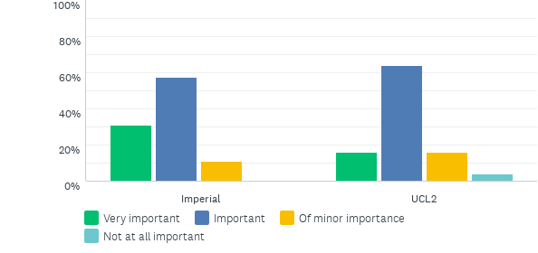
Q10: 70. That the partner’s behaviour is not appropriate for a hospital
Answered: 236 Skipped: 6

Slide 22
Q10: 70. That the partner’s behaviour is not appropriate for a hospital
Answered: 236 Skipped: 6

Slide 23
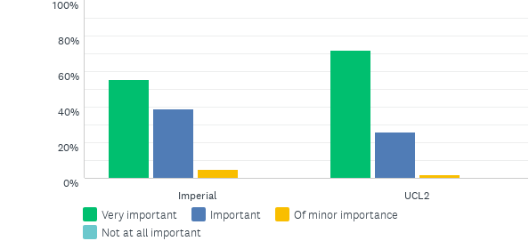
Q11: 71. That Helen may need support to deal with her partner’s anger
Answered: 236 Skipped: 6

Slide 24
Q11: 71. That Helen may need support to deal with her partner’s anger
Answered: 236 Skipped: 6

Slide 25
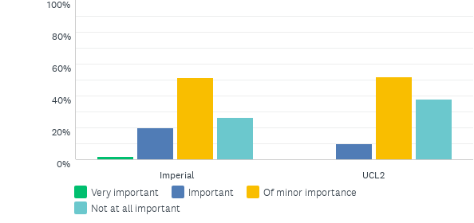
Q12: 72. That it is not your job to mediate between patients and their families
Answered: 236 Skipped: 6

Slide 26
Q12: 72. That it is not your job to mediate between patients and their families
Answered: 236 Skipped: 6

Slide 27
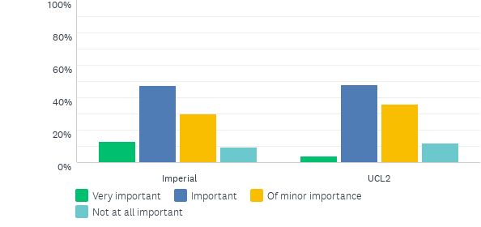
Q13: 73. That hospital security might be better qualified to intervene in the discussion.
Answered: 236 Skipped: 6

Slide 28
Q13: 73. That hospital security might be better qualified to intervene in the discussion.
Answered: 236 Skipped: 6

Slide 29
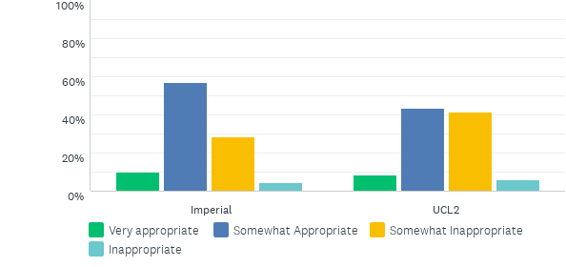
Q14: 74. “Would it be possible to switch back to the previous rota?”
Answered: 234 Skipped: 8

Slide 30
Q14: 74. “Would it be possible to switch back to the previous rota?”
Answered: 234 Skipped: 8

Slide 31
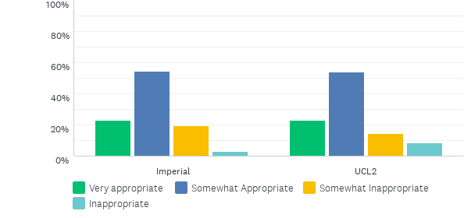
Q15: 75. “Everyone is struggling to adjust to the new rota; I think they preferred the old rota.”
Answered: 234 Skipped: 8

Slide 32
Q15: 75. “Everyone is struggling to adjust to the new rota; I think they preferred the old rota.”
Answered: 234 Skipped: 8

Slide 33
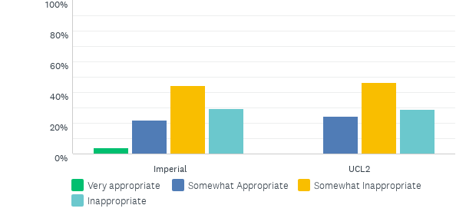
Q16: 76. “Was it necessary to change the rota?”
Answered: 231 Skipped: 11

Slide 34
Q16: 76. “Was it necessary to change the rota?”
Answered: 231 Skipped: 11

Slide 35
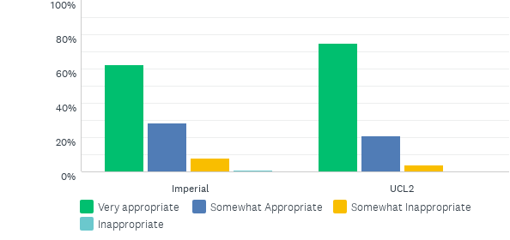
Q17: 77. “I have noticed that everyone is more tired and team morale seems low since you changed the rota.”
Answered: 234 Skipped: 8

Slide 36
Q17: 77. “I have noticed that everyone is more tired and team morale seems low since you changed the rota.”
Answered: 234 Skipped: 8

Slide 37
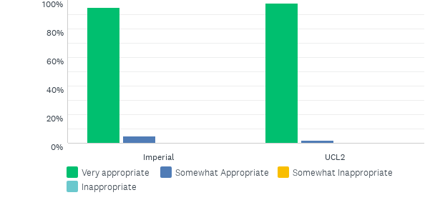
Q18: 78. “It might be a good idea to discuss the new rota at a meeting with the whole team.”
Answered: 234 Skipped: 8

Slide 38
Q18: 78. “It might be a good idea to discuss the new rota at a meeting with the whole team.”
Answered: 234 Skipped: 8

Slide 39
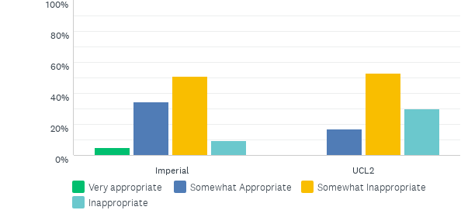
Q19: 79. “I think people need some time to adjust to the new rota.”
Answered: 232 Skipped: 10

Slide 40
Q19: 79. “I think people need some time to adjust to the new rota.”
Answered: 232 Skipped: 10

Slide 41
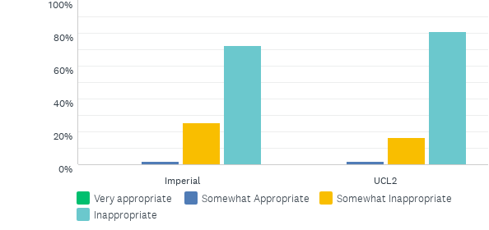
Q20: 80. “It’s not too bad.”
Answered: 234 Skipped: 8

Slide 42
Q20: 80. “It’s not too bad.”
Answered: 234 Skipped: 8

Slide 43
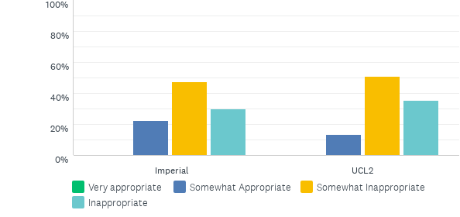
Q21: 81. Ignore the nurses, leaving the staff room to eat your lunch elsewhere.
Answered: 231 Skipped: 11

Slide 44
Q21: 81. Ignore the nurses, leaving the staff room to eat your lunch elsewhere.
Answered: 231 Skipped: 11

Slide 45
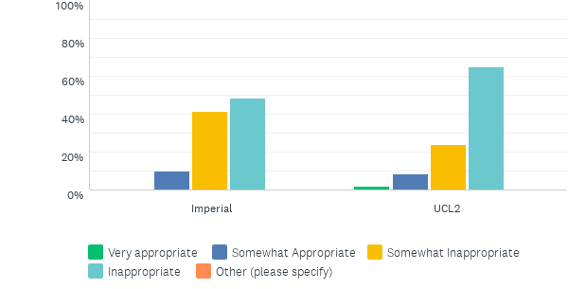
Q22: 82. Find the FY2 to tell her what you heard the nurses saying about her.
Answered: 232 Skipped: 10

Slide 46
Q22: 82. Find the FY2 to tell her what you heard the nurses saying about her.
Answered: 232 Skipped: 10

Slide 47
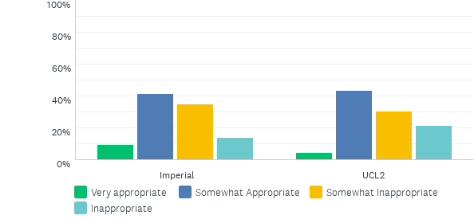
Q23: 83. Inform a senior colleague that the FY2’s behaviour is upsetting the nursing staff.
Answered: 232 Skipped: 10

Slide 48
Q23: 83. Inform a senior colleague that the FY2’s behaviour is upsetting the nursing staff.
Answered: 232 Skipped: 10

Slide 49
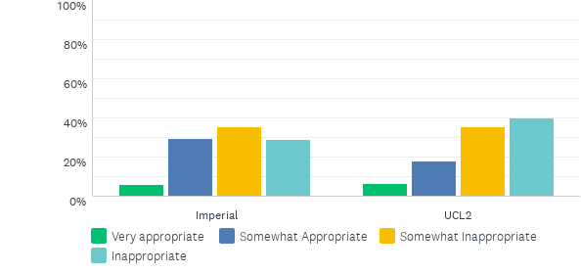
Q24: 84. Advise the nurses you are aware of a change in the FY2’s behaviour, discussing this in more detail with them.
Answered: 231 Skipped: 11

Slide 50
Q24: 84. Advise the nurses you are aware of a change in the FY2’s behaviour, discussing this in more detail with them.
Answered: 231 Skipped: 11

Slide 51
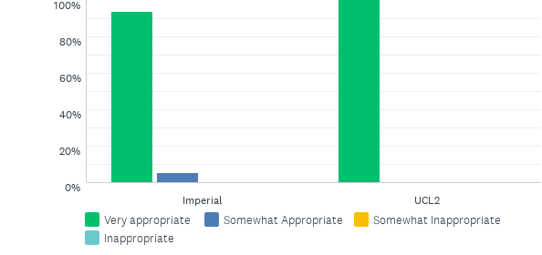
Q25: “85. Speak to your FY2 colleague to find out if there is a reason for the recent change in her behaviour.
Answered: 232 Skipped: 10

Slide 52
Q25: “85. Speak to your FY2 colleague to find out if there is a reason for the recent change in her behaviour.
Answered: 232 Skipped: 10

Slide 53
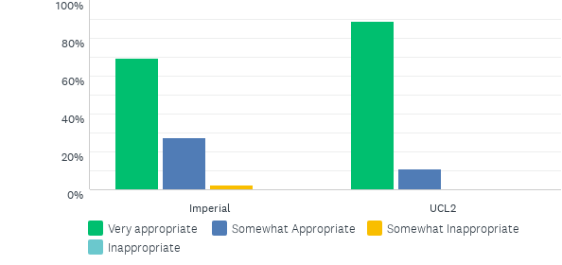
Q26: 86. Suggest the nurses speak to the FY2 directly if they are unhappy with her conduct
Answered: 231 Skipped: 11

Slide 54
Q26: 86. Suggest the nurses speak to the FY2 directly if they are unhappy with her conduct
Answered: 231 Skipped: 11

Slide 55
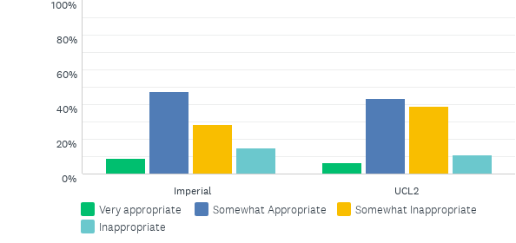
Q27: 87. Speak to other colleagues on your ward to see if they have noticed a change in the FY2’s behaviour.
Answered: 232 Skipped: 10

Slide 56
Q27: 87. Speak to other colleagues on your ward to see if they have noticed a change in the FY2’s behaviour.
Answered: 232 Skipped: 10

Slide 57
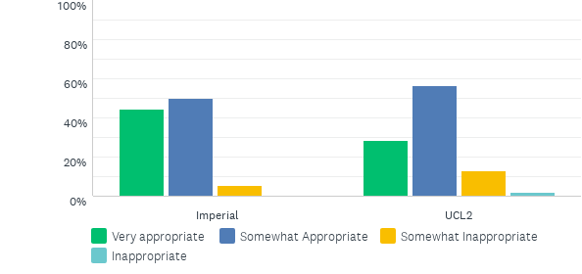
Q28: 88. Advise the FY2 that you have observed a change in behaviour that is having a negative impact at work.
Answered: 232 Skipped: 10

Slide 58
Q28: 88. Advise the FY2 that you have observed a change in behaviour that is having a negative impact at work.
Answered: 232 Skipped: 10

Slide 59
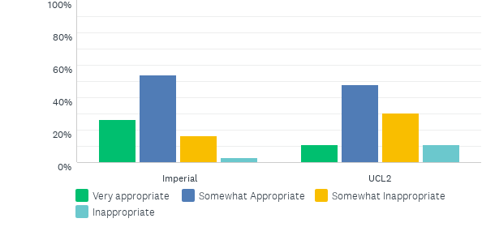
Q29: 89. Reassure the FY2 she will feel less stressed when the exam is over
Answered: 232 Skipped: 10

Slide 60
Q29: 89. Reassure the FY2 she will feel less stressed when the exam is over
Answered: 232 Skipped: 10

Slide 61
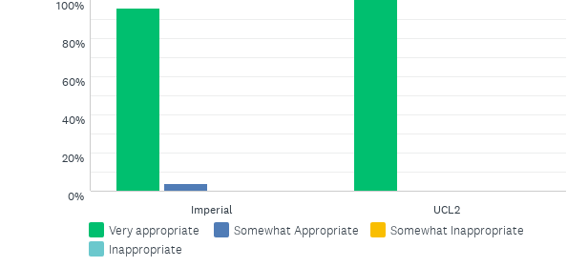
Q30: 90. Ask the FY2 if she has considered speaking to her educational supervisor* about how she is feeling.
Answered: 232 Skipped: 10

Slide 62
Q30: 90. Ask the FY2 if she has considered speaking to her educational supervisor* about how she is feeling.
Answered: 232 Skipped: 10

Slide 63
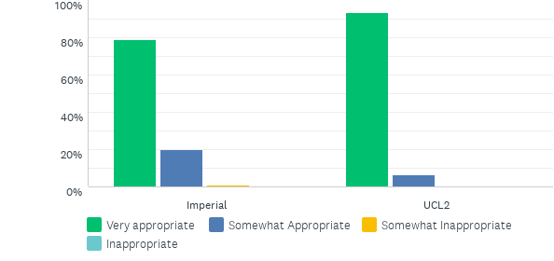
Q31: 91. Ask the FY2 more about how she is feeling at work
Answered: 232 Skipped: 10

Slide 64
Q31: 91. Ask the FY2 more about how she is feeling at work
Answered: 232 Skipped: 10

Slide 65
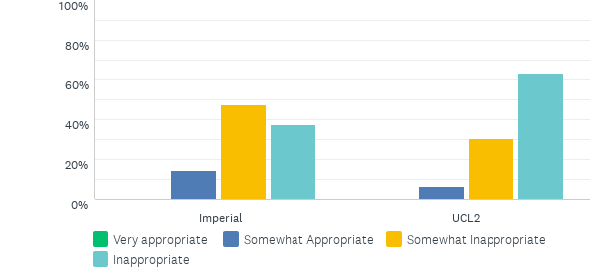
Q32: 92. Suggest taking on some of the FY2’s workload to allow her more time to study.
Answered: 232 Skipped: 10

Slide 66
Q32: 92. Suggest taking on some of the FY2’s workload to allow her more time to study.
Answered: 232 Skipped: 10

Slide 67
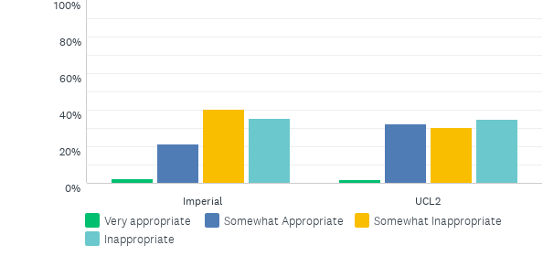
Q33: 93. Suggest the FY2 goes home if she does not feel able to work
Answered: 232 Skipped: 10

Slide 68
Q33: 93. Suggest the FY2 goes home if she does not feel able to work
Answered: 232 Skipped: 10

Slide 69
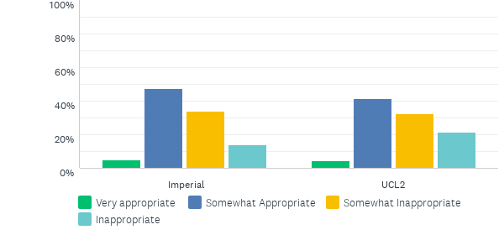
Q34: 94. Tell the FY2 that some of the nurses have noticed a change in her behaviour
Answered: 232 Skipped: 10

Slide 70
Q34: 94. Tell the FY2 that some of the nurses have noticed a change in her behaviour
Answered: 232 Skipped: 10

Slide 71
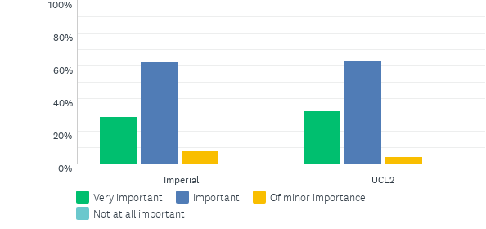
Q35: 95. That the ward nurse in charge must have a reason for wanting you stay
Answered: 231 Skipped: 11

Slide 72
Q35: 95. That the ward nurse in charge must have a reason for wanting you stay
Answered: 231 Skipped: 11

Slide 73
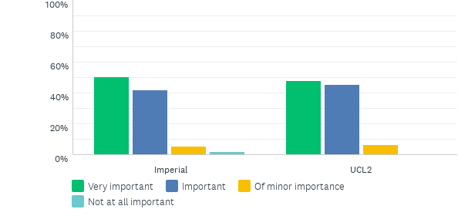
Q36: 96. That the consultant probably knows the requirements of both wards the best.
Answered: 232 Skipped: 10

Slide 74
Q36: 96. That the consultant probably knows the requirements of both wards the best.
Answered: 232 Skipped: 10

Slide 75
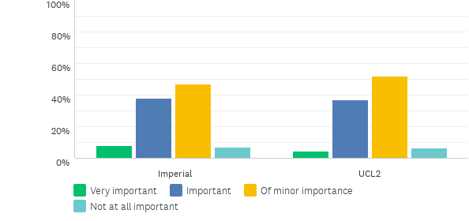
Q37: 97. That you might learn more if you go and help out on an understaffed ward
Answered: 232 Skipped: 10

Slide 76
Q37: 97. That you might learn more if you go and help out on an understaffed ward
Answered: 232 Skipped: 10

Slide 77
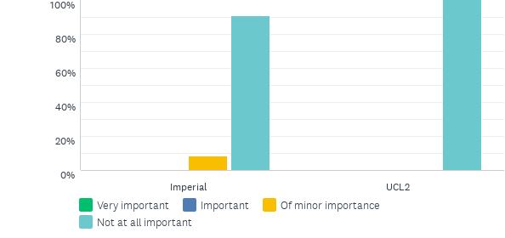
Q38: 98. That you might have an easier afternoon if you stay on your current ward.
Answered: 232 Skipped: 10

Slide 78
Q38: 98. That you might have an easier afternoon if you stay on your current ward.
Answered: 232 Skipped: 10

Slide 79
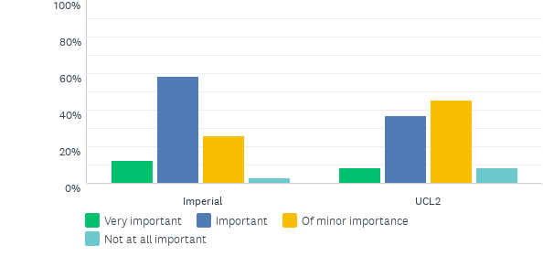
Q39: 99. That the consultant expects you to do as you are told
Answered: 231 Skipped: 11

Slide 80
Q39: 99. That the consultant expects you to do as you are told
Answered: 231 Skipped: 11

Slide 81
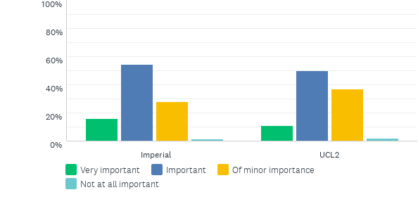
Q40: 100. That your relationship with the ward nurse in charge might be negatively affected if you go to the other ward.
Answered: 232 Skipped: 10

Slide 82
Q40: 100. That your relationship with the ward nurse in charge might be negatively affected if you go to the other ward.
Answered: 232 Skipped: 10

Slide 83
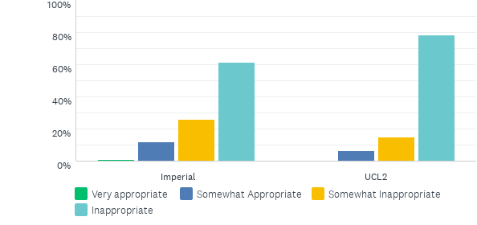
Q41: 101. “Don’t worry, your father will be transferred next week.”
Answered: 232 Skipped: 10

Slide 84
Q41: 101. “Don’t worry, your father will be transferred next week.”
Answered: 232 Skipped: 10

Slide 85
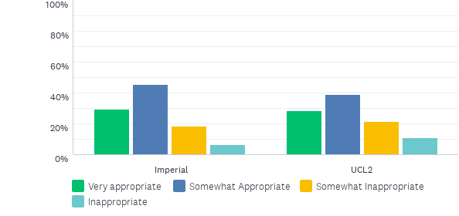
Q42: 102. “Have you discussed how exhausted you are with your father?”
Answered: 232 Skipped: 10

Slide 86
Q42: 102. “Have you discussed how exhausted you are with your father?”
Answered: 232 Skipped: 10

Slide 87
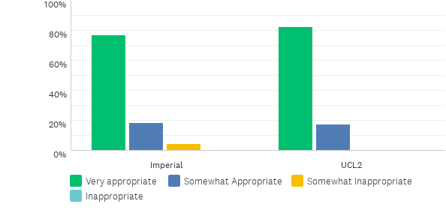
Q43: 103. “Your father’s health is the most important thing to consider in deciding whether he can be transferred.”
Answered: 232 Skipped: 10

Slide 88
Q43: 103. “Your father’s health is the most important thing to consider in deciding whether he can be transferred.”
Answered: 232 Skipped: 10

Slide 89
Q44: 104. “It is not necessary for you to visit every day, I am sure he would be OK.”
Answered: 231 Skipped: 11

Slide 90
Q44: 104. “It is not necessary for you to visit every day, I am sure he would be OK.”
Answered: 231 Skipped: 11

Slide 91
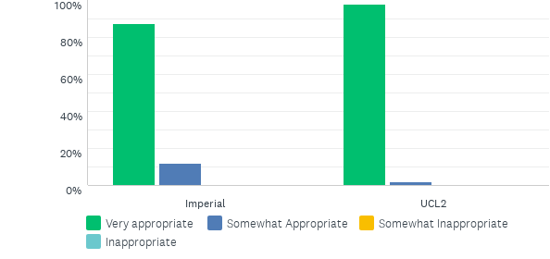
Q45: 105. “I understand, it must be very tiring for you.”
Answered: 232 Skipped: 10

Slide 92
Q45: 105. “I understand, it must be very tiring for you.”
Answered: 232 Skipped: 10

Slide 93
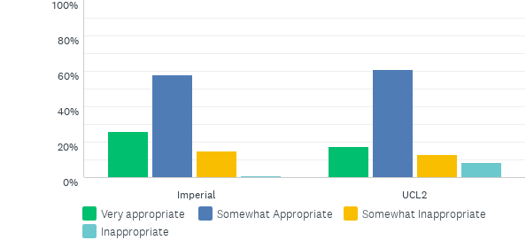
Q46: 106. “Could you speak with your father on the phone, rather than visiting so often?”
Answered: 232 Skipped: 10

Slide 94
Q46: 106. “Could you speak with your father on the phone, rather than visiting so often?”
Answered: 232 Skipped: 10

Slide 95
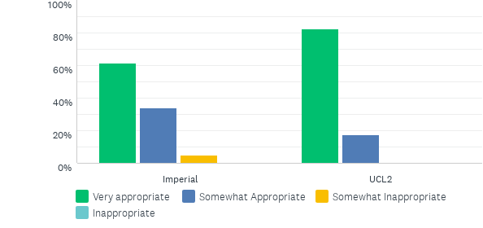
Q47: 107. “It is important that you consider the impact that this is having on your own health.”
Answered: 232 Skipped: 10

Slide 96
Q47: 107. “It is important that you consider the impact that this is having on your own health.”
Answered: 232 Skipped: 10

Slide 97
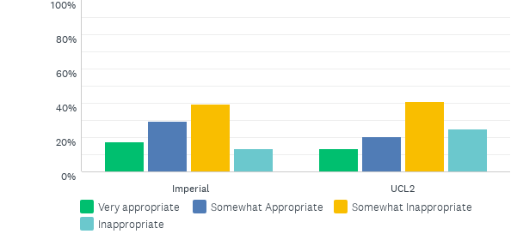
Q48: 108. Immediately ask to speak with Jeremy privately to discuss this with him further
Answered: 228 Skipped: 14

Slide 98
Q48: 108. Immediately ask to speak with Jeremy privately to discuss this with him further
Answered: 228 Skipped: 14

Slide 99
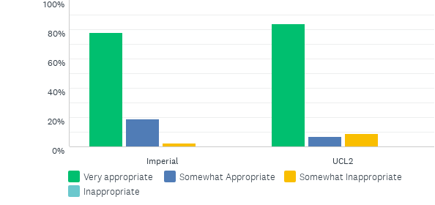
Q49: 109. Apologise to Mrs McDermott if Jeremy’s comment has confused her
Answered: 229 Skipped: 13

Slide 100
Q49: 109. Apologise to Mrs McDermott if Jeremy’s comment has confused her
Answered: 229 Skipped: 13

Slide 101
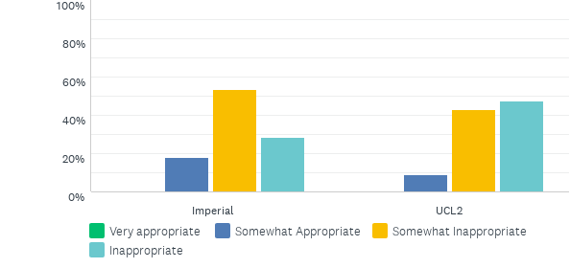
Q50: 110. Ignore Jeremy’s comment and continue the conversation with Mrs McDermott
Answered: 229 Skipped: 13

Slide 102
Q50: 110. Ignore Jeremy’s comment and continue the conversation with Mrs McDermott
Answered: 229 Skipped: 13

Slide 103
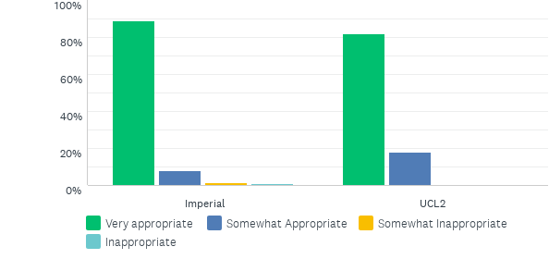
Q51: 111. After the consultation, explain to Jeremy that that was an inappropriate time to bring up the article.
Answered: 229 Skipped: 13

Slide 104
Q51: 111. After the consultation, explain to Jeremy that that was an inappropriate time to bring up the article.
Answered: 229 Skipped: 13

Slide 105
Q52: 112. Explain to Mrs McDermott that Jeremy is still studying for his medical degree.
Answered: 229 Skipped: 13

Slide 106
Q52: 112. Explain to Mrs McDermott that Jeremy is still studying for his medical degree.
Answered: 229 Skipped: 13

Slide 107
Q53: 113. Ask Jeremy to explain to the patient why he believes his alternative drug is more effective
Answered: 229 Skipped: 13

Slide 108
Q53: 113. Ask Jeremy to explain to the patient why he believes his alternative drug is more effective
Answered: 229 Skipped: 13

Slide 109
Q54: 114. After the consultation, explain to Jeremy that raising his idea in front of Mrs McDermott caused her to be confused
Answered: 228 Skipped: 14

Slide 110
Q54: 114. After the consultation, explain to Jeremy that raising his idea in front of Mrs McDermott caused her to be confused
Answered: 228 Skipped: 14

