Slide 1
rating SJT
Friday, November 06, 2020

Slide 2
236
Total Responses
Date Created: Tuesday, October 27, 2020
Complete Responses: 227

Slide 3
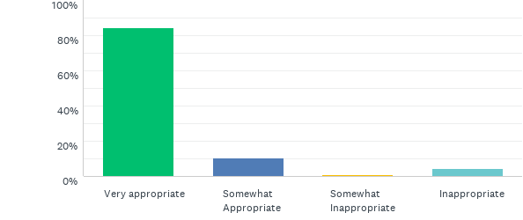
Q1: Provide Sarah with some publicly available information about medical school examinations
Answered: 234 Skipped: 2

Slide 4
Q1: Provide Sarah with some publicly available information about medical school examinations
Answered: 234 Skipped: 2

Slide 5
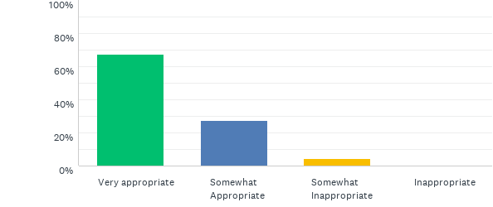
Q2: Tell Sarah that it could be considered cheating if she tried to find out the scenarios beforehand
Answered: 233 Skipped: 3

Slide 6
Q2: Tell Sarah that it could be considered cheating if she tried to find out the scenarios beforehand
Answered: 233 Skipped: 3

Slide 7
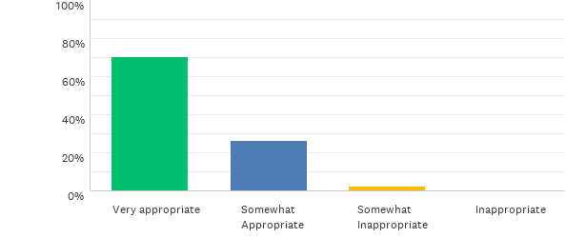
Q3: Explain to Sarah that it would be unfair on other candidates if only she knew the interview questions before the clinical exam
Answered: 234 Skipped: 2

Slide 8
Q3: Explain to Sarah that it would be unfair on other candidates if only she knew the interview questions before the clinical exam
Answered: 234 Skipped: 2

Slide 9
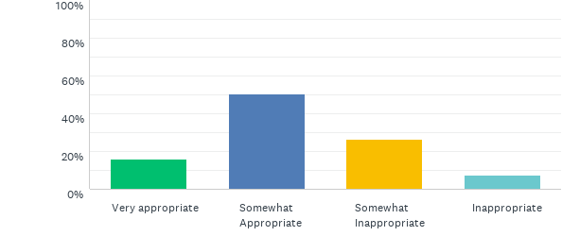
Q4: Tell Sarah that she has put you in a difficult position by asking you that
Answered: 234 Skipped: 2

Slide 10
Q4: Tell Sarah that she has put you in a difficult position by asking you that
Answered: 234 Skipped: 2

Slide 11
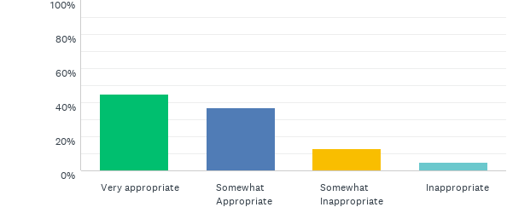
Q5: Reassure Sarah that she should not need to know the scenarios before the clinical exam in order to do well
Answered: 234 Skipped: 2

Slide 12
Q5: Reassure Sarah that she should not need to know the scenarios before the clinical exam in order to do well
Answered: 234 Skipped: 2

Slide 13
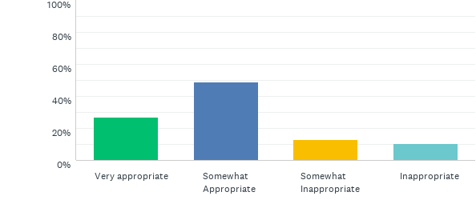
Q6: Advise Sarah to ask another FY1 colleague, who is not a facilitator on the clinical exam, to help with exam practice
Answered: 235 Skipped: 1

Slide 14
Q6: Advise Sarah to ask another FY1 colleague, who is not a facilitator on the clinical exam, to help with exam practice
Answered: 235 Skipped: 1

Slide 15
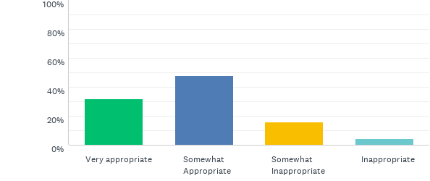
Q7: Ask Sarah exactly how much information James has told her
Answered: 232 Skipped: 4

Slide 16
Q7: Ask Sarah exactly how much information James has told her
Answered: 232 Skipped: 4

Slide 17
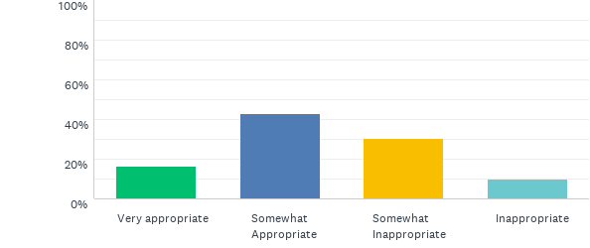
Q8: Ask Sarah why she has chosen to also ask James for information
Answered: 232 Skipped: 4

Slide 18
Q8: Ask Sarah why she has chosen to also ask James for information
Answered: 232 Skipped: 4

Slide 19
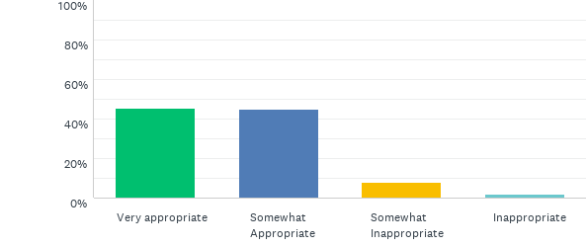
Q9: Tell Sarah that you will need to inform her educational supervisor* about the situation
Answered: 232 Skipped: 4

Slide 20
Q9: Tell Sarah that you will need to inform her educational supervisor* about the situation
Answered: 232 Skipped: 4

Slide 21
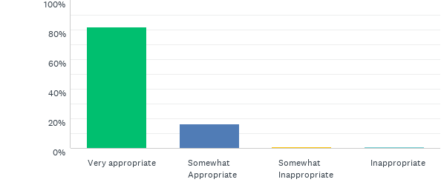
Q10: Encourage Sarah to declare to the medical school that she has been told information about the clinical exam
Answered: 232 Skipped: 4

Slide 22
Q10: Encourage Sarah to declare to the medical school that she has been told information about the clinical exam
Answered: 232 Skipped: 4

Slide 23
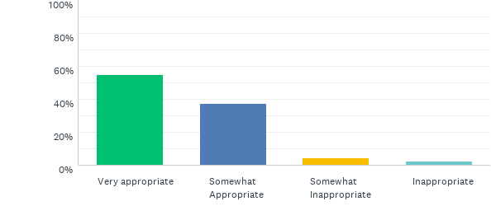
Q11: Explore with Sarah why she feels she needs to know the information
Answered: 232 Skipped: 4

Slide 24
Q11: Explore with Sarah why she feels she needs to know the information
Answered: 232 Skipped: 4

Slide 25
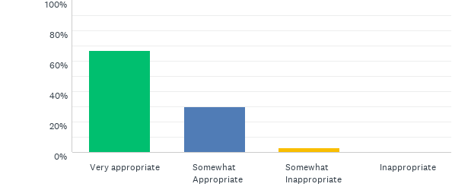
Q12: “Please be assured that I will try my best to find out the cause of your pain.”
Answered: 231 Skipped: 5

Slide 26
Q12: “Please be assured that I will try my best to find out the cause of your pain.”
Answered: 231 Skipped: 5

Slide 27
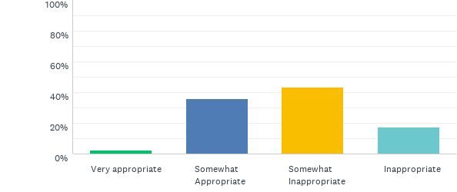
Q13: “I’m here to help you, please don’t speak to me in that way.”
Answered: 231 Skipped: 5

Slide 28
Q13: “I’m here to help you, please don’t speak to me in that way.”
Answered: 231 Skipped: 5

Slide 29
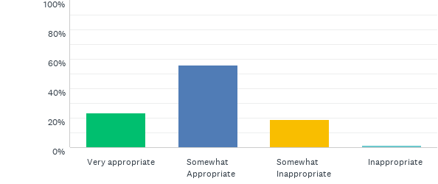
Q14: “Let me see if a senior doctor is available to assess you instead.”
Answered: 231 Skipped: 5

Slide 30
Q14: “Let me see if a senior doctor is available to assess you instead.”
Answered: 231 Skipped: 5

Slide 31
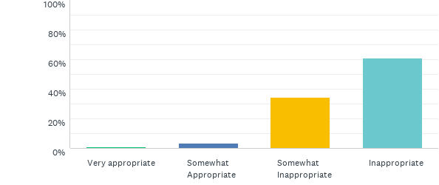
Q15: “I’m sorry you feel that way, but it is not my fault you are still experiencing pain.”
Answered: 231 Skipped: 5

Slide 32
Q15: “I’m sorry you feel that way, but it is not my fault you are still experiencing pain.”
Answered: 231 Skipped: 5

Slide 33
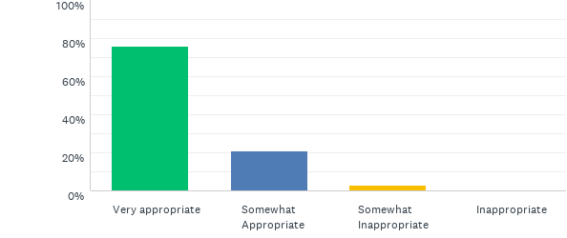
Q16: “I understand that being in and out of hospital must be frustrating for you.”
Answered: 231 Skipped: 5

Slide 34
Q16: “I understand that being in and out of hospital must be frustrating for you.”
Answered: 231 Skipped: 5

Slide 35
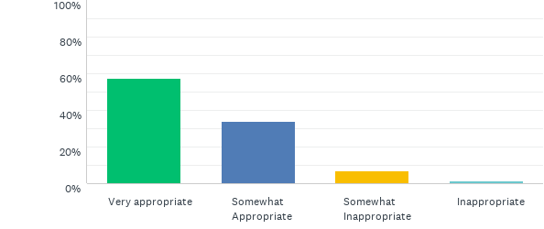
Q17: “I can see if a senior doctor is available, however, you might end up having to wait a while to be seen.”
Answered: 231 Skipped: 5

Slide 36
Q17: “I can see if a senior doctor is available, however, you might end up having to wait a while to be seen.”
Answered: 231 Skipped: 5

Slide 37
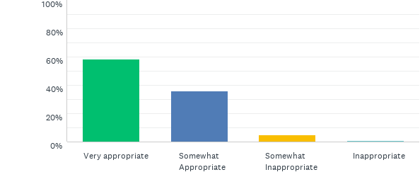
Q18: “I understand it must be frustrating to have long-term health problems.”
Answered: 231 Skipped: 5

Slide 38
Q18: “I understand it must be frustrating to have long-term health problems.”
Answered: 231 Skipped: 5

Slide 39
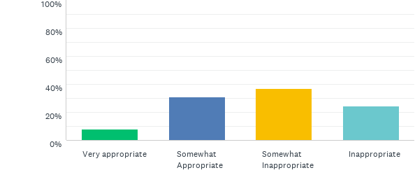
Q19: “Since your chest pain has been dealt with, you’re now being discharged from the Emergency Department.”
Answered: 230 Skipped: 6

Slide 40
Q19: “Since your chest pain has been dealt with, you’re now being discharged from the Emergency Department.”
Answered: 230 Skipped: 6

Slide 41
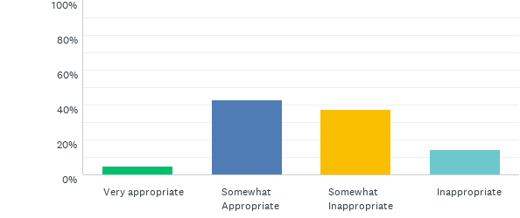
Q20: “I don’t have long, but I will see what I can do to help.”
Answered: 231 Skipped: 5

Slide 42
Q20: “I don’t have long, but I will see what I can do to help.”
Answered: 231 Skipped: 5

Slide 43
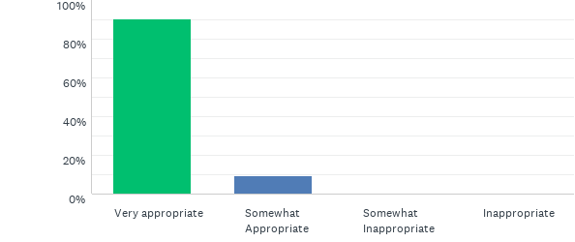
Q21: “I’d advise you to book an appointment with your GP* to discuss your long-term health problems.”
Answered: 231 Skipped: 5

Slide 44
Q21: “I’d advise you to book an appointment with your GP* to discuss your long-term health problems.”
Answered: 231 Skipped: 5

Slide 45
Q22: “Is there something specific concerning you about your long-term health problems?”
Answered: 231 Skipped: 5

Slide 46
Q22: “Is there something specific concerning you about your long-term health problems?”
Answered: 231 Skipped: 5

Slide 47
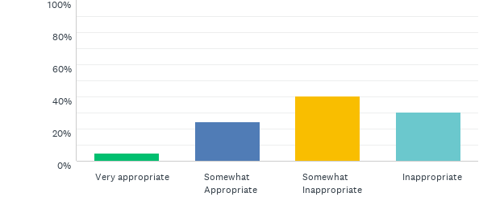
Q23: “The Emergency Department is busy so unfortunately I need to prioritise other patients.”
Answered: 231 Skipped: 5

Slide 48
Q23: “The Emergency Department is busy so unfortunately I need to prioritise other patients.”
Answered: 231 Skipped: 5

Slide 49
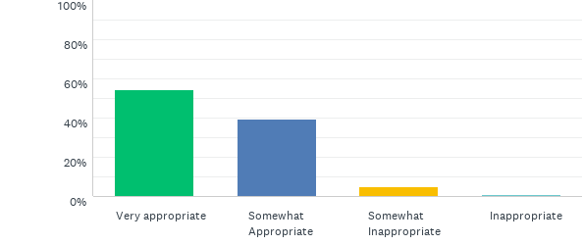
Q24: “You know that this is confidential information that I cannot discuss with you.”
Answered: 229 Skipped: 7

Slide 50
Q24: “You know that this is confidential information that I cannot discuss with you.”
Answered: 229 Skipped: 7

Slide 51
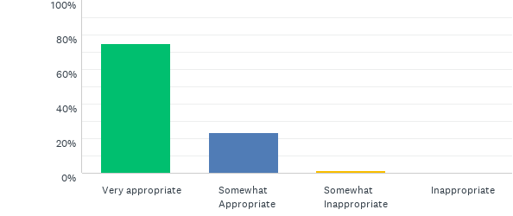
Q25: “You will need to speak with your niece’s parents directly about this.”
Answered: 228 Skipped: 8

Slide 52
Q25: “You will need to speak with your niece’s parents directly about this.”
Answered: 228 Skipped: 8

Slide 53
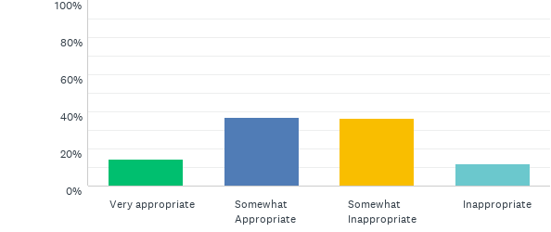
Q26: “Perhaps you should visit your niece when you finish your shift to check on her.”
Answered: 229 Skipped: 7

Slide 54
Q26: “Perhaps you should visit your niece when you finish your shift to check on her.”
Answered: 229 Skipped: 7

Slide 55
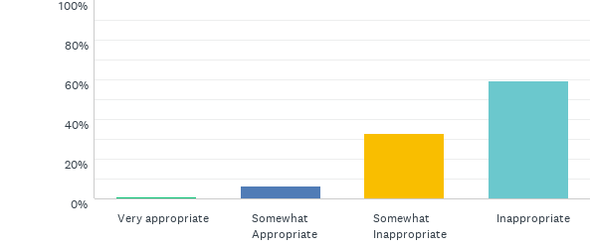
Q27: “Try not to worry. I’m sure everything is going to be fine.”
Answered: 229 Skipped: 7

Slide 56
Q27: “Try not to worry. I’m sure everything is going to be fine.”
Answered: 229 Skipped: 7

Slide 57
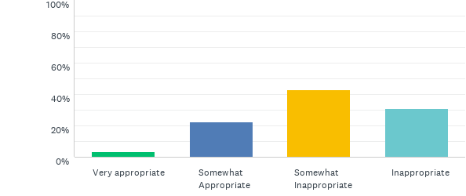
Q28: “It is inappropriate for you to ask this of me so please do not ask me again.”
Answered: 229 Skipped: 7

Slide 58
Q28: “It is inappropriate for you to ask this of me so please do not ask me again.”
Answered: 229 Skipped: 7

Slide 59
Q29: Ask the nurse directly which patient notes he was reading
Answered: 229 Skipped: 7

Slide 60
Q29: Ask the nurse directly which patient notes he was reading
Answered: 229 Skipped: 7

Slide 61
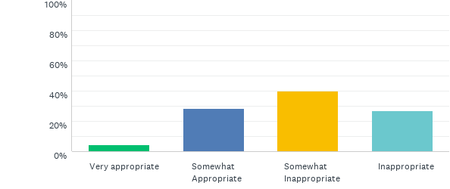
Q30: Report the nurse for reading confidential patient notes
Answered: 229 Skipped: 7

Slide 62
Q30: Report the nurse for reading confidential patient notes
Answered: 229 Skipped: 7

Slide 63
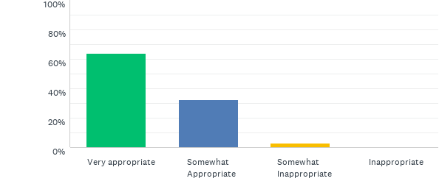
Q31: 31. Ask the nurse in charge for advice about how to respond
Answered: 229 Skipped: 7

Slide 64
Q31: 31. Ask the nurse in charge for advice about how to respond
Answered: 229 Skipped: 7

Slide 65
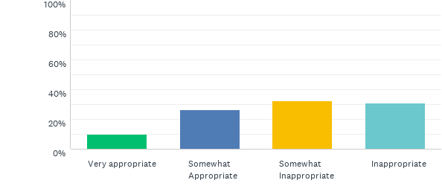
Q32: Tell the patient’s parents that you suspect the nurse was reading their daughter’s notes
Answered: 229 Skipped: 7

Slide 66
Q32: Tell the patient’s parents that you suspect the nurse was reading their daughter’s notes
Answered: 229 Skipped: 7

Slide 67
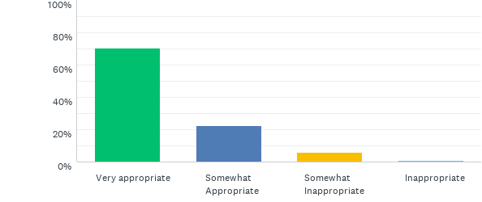
Q33: Ask the nurse why he was reading a set of patient notes for a ward he does not work on
Answered: 229 Skipped: 7

Slide 68
Q33: Ask the nurse why he was reading a set of patient notes for a ward he does not work on
Answered: 229 Skipped: 7

Slide 69
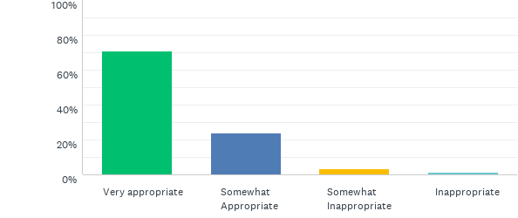
Q34: “Is there anything else upsetting you?”
Answered: 228 Skipped: 8

Slide 70
Q34: “Is there anything else upsetting you?”
Answered: 228 Skipped: 8

Slide 71
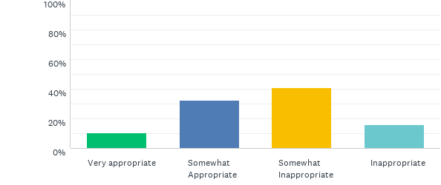
Q35: “It is up to you whether or not you go home.”
Answered: 228 Skipped: 8

Slide 72
Q35: “It is up to you whether or not you go home.”
Answered: 228 Skipped: 8

Slide 73
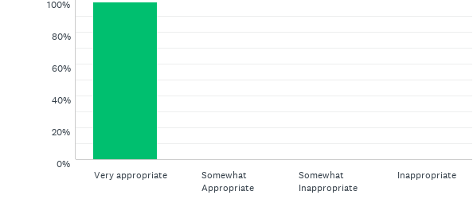
Q36: “Is there is a particular reason why you do not want to have surgery?”
Answered: 228 Skipped: 8

Slide 74
Q36: “Is there is a particular reason why you do not want to have surgery?”
Answered: 228 Skipped: 8

Slide 75
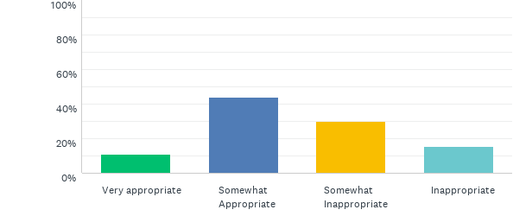
Q37: “While there is a chance you will need surgery, you might not.”
Answered: 228 Skipped: 8

Slide 76
Q37: “While there is a chance you will need surgery, you might not.”
Answered: 228 Skipped: 8

Slide 77
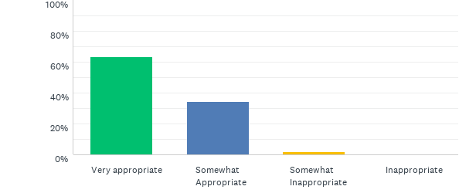
Q38: “You’re in the best place to be treated effectively.”
Answered: 227 Skipped: 9

Slide 78
Q38: “You’re in the best place to be treated effectively.”
Answered: 227 Skipped: 9

Slide 79
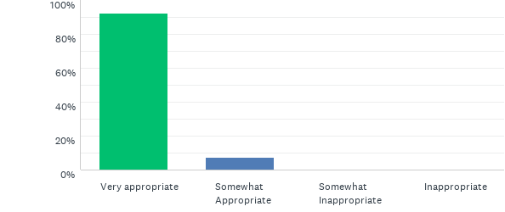
Q39: “Do you have any family members or friends who can come to support you?”
Answered: 228 Skipped: 8

Slide 80
Q39: “Do you have any family members or friends who can come to support you?”
Answered: 228 Skipped: 8

Slide 81
Q40: “We would like you to stay to receive the best treatment.”
Answered: 229 Skipped: 7

Slide 82
Q40: “We would like you to stay to receive the best treatment.”
Answered: 229 Skipped: 7

Slide 83
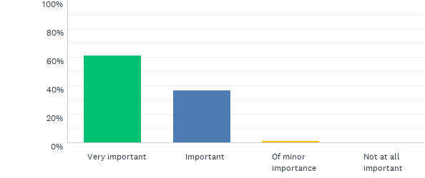
Q41: The impact on the rest of the ward staff if you leave work now
Answered: 226 Skipped: 10

Slide 84
Q41: The impact on the rest of the ward staff if you leave work now
Answered: 226 Skipped: 10

Slide 85
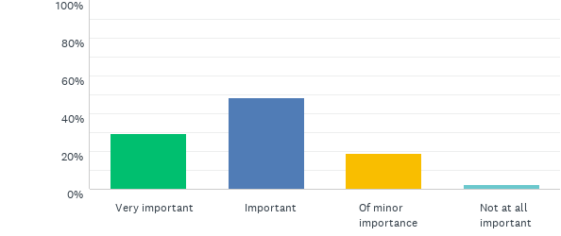
Q42: Your ability to handle stressful situations in the future
Answered: 226 Skipped: 10

Slide 86
Q42: Your ability to handle stressful situations in the future
Answered: 226 Skipped: 10

Slide 87
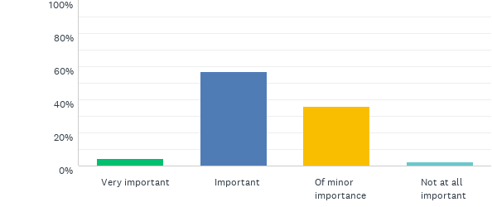
Q43: Your ongoing relationship with Cathy
Answered: 226 Skipped: 10

Slide 88
Q43: Your ongoing relationship with Cathy
Answered: 226 Skipped: 10

Slide 89
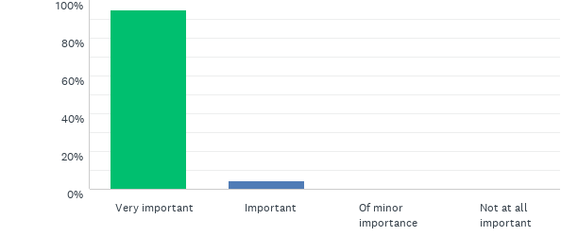
Q44: The risk to patient safety if you complete your shift feeling like you do
Answered: 226 Skipped: 10

Slide 90
Q44: The risk to patient safety if you complete your shift feeling like you do
Answered: 226 Skipped: 10

Slide 91
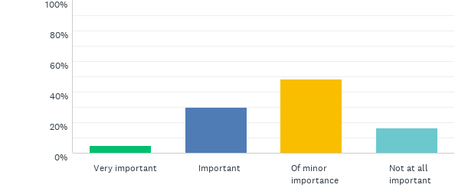
Q45: The amount of time you have left to complete
Answered: 226 Skipped: 10

Slide 92
Q45: The amount of time you have left to complete
Answered: 226 Skipped: 10

Slide 93
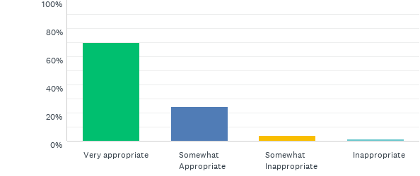
Q46: Reassure the parents that the delay in giving the drug will not cause harm to their child
Answered: 227 Skipped: 9

Slide 94
Q46: Reassure the parents that the delay in giving the drug will not cause harm to their child
Answered: 227 Skipped: 9

Slide 95
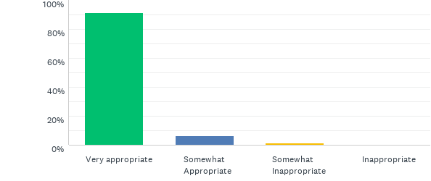
Q47: Explain to the parents that you and the nurse are making sure that the dose is correct and safe before it is given
Answered: 227 Skipped: 9

Slide 96
Q47: Explain to the parents that you and the nurse are making sure that the dose is correct and safe before it is given
Answered: 227 Skipped: 9

Slide 97
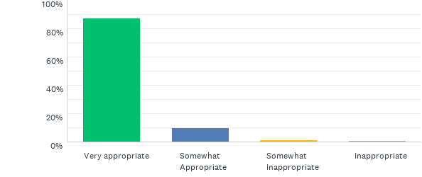
Q48: Ask the nurse if you can both go through the drug calculation together to try and agree on the dose
Answered: 226 Skipped: 10

Slide 98
Q48: Ask the nurse if you can both go through the drug calculation together to try and agree on the dose
Answered: 226 Skipped: 10

Slide 99
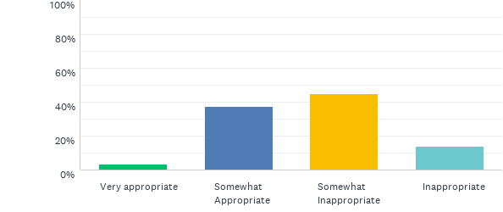
Q49: Inform the nurse that you believe your calculations are correct
Answered: 227 Skipped: 9

Slide 100
Q49: Inform the nurse that you believe your calculations are correct
Answered: 227 Skipped: 9

Slide 101
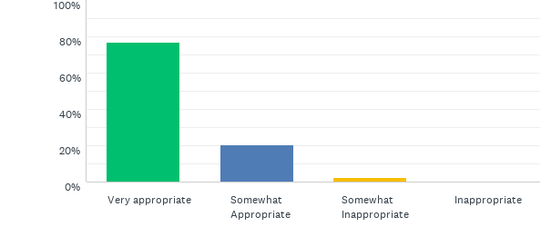
Q50: Apologise to the parents for the delay
Answered: 227 Skipped: 9

Slide 102
Q50: Apologise to the parents for the delay
Answered: 227 Skipped: 9

Slide 103
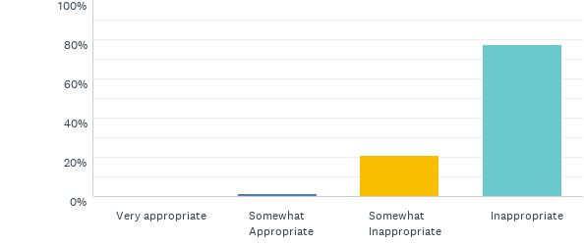
Q51: Tell the parents that the delay is because the nurse thinks your drug calculations are wrong
Answered: 227 Skipped: 9

Slide 104
Q51: Tell the parents that the delay is because the nurse thinks your drug calculations are wrong
Answered: 227 Skipped: 9

Slide 105
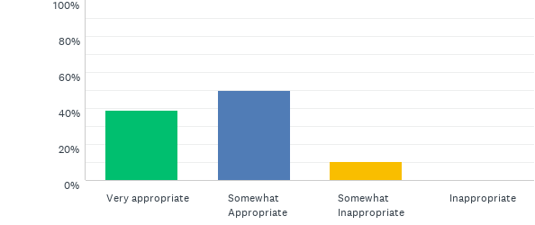
Q52: Ask the consultant to confirm with yourself and the nurse what dose to give
Answered: 227 Skipped: 9

Slide 106
Q52: Ask the consultant to confirm with yourself and the nurse what dose to give
Answered: 227 Skipped: 9

Slide 107
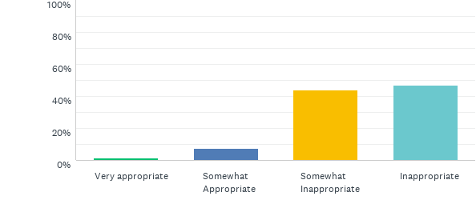
Q53: Avoid having a conversation with the parents before you have sorted out the issue with the drug dose
Answered: 227 Skipped: 9

Slide 108
Q53: Avoid having a conversation with the parents before you have sorted out the issue with the drug dose
Answered: 227 Skipped: 9

Slide 109
Q54: “Politely explain to Joanne that you are busy checking the prescriptions of your patients and do not have time to double check hers
Answered: 227 Skipped: 9

Slide 110
Q54: “Politely explain to Joanne that you are busy checking the prescriptions of your patients and do not have time to double check hers
Answered: 227 Skipped: 9

Slide 111
Q55: Double check the prescriptions, as per Joanne’s request
Answered: 227 Skipped: 9

Slide 112
Q55: Double check the prescriptions, as per Joanne’s request
Answered: 227 Skipped: 9

Slide 113
Q56: Ask Joanne if there is a particular reason why she believes her patient’s prescriptions should be double checked
Answered: 227 Skipped: 9

Slide 114
Q56: Ask Joanne if there is a particular reason why she believes her patient’s prescriptions should be double checked
Answered: 227 Skipped: 9

Slide 115
Q57: Inform Joanne’s clinical supervisor* that she keeps asking you to double check her work
Answered: 227 Skipped: 9

Slide 116
Q57: Inform Joanne’s clinical supervisor* that she keeps asking you to double check her work
Answered: 227 Skipped: 9

Slide 117
Q58: Go to another room where you can continue to work alone
Answered: 227 Skipped: 9

Slide 118
Q58: Go to another room where you can continue to work alone
Answered: 227 Skipped: 9

Slide 119
Q59: Discuss the situation with your clinical supervisor
Answered: 227 Skipped: 9

Slide 120
Q59: Discuss the situation with your clinical supervisor
Answered: 227 Skipped: 9

Slide 121
Q60: Tell Joanne that you are sure she has written down the correct results
Answered: 227 Skipped: 9

Slide 122
Q60: Tell Joanne that you are sure she has written down the correct results
Answered: 227 Skipped: 9

